Slide 1



TSE for Sustainable Futures
Welcome to Turku School of Economics

Slide 2

Milestones
Established
1950
by the local business community
State university since
1977
Executive education started 1982
Merged with the University of Turku
2010
AACSB accreditation awarded
2019
TSE Pori established
1984

Slide 3
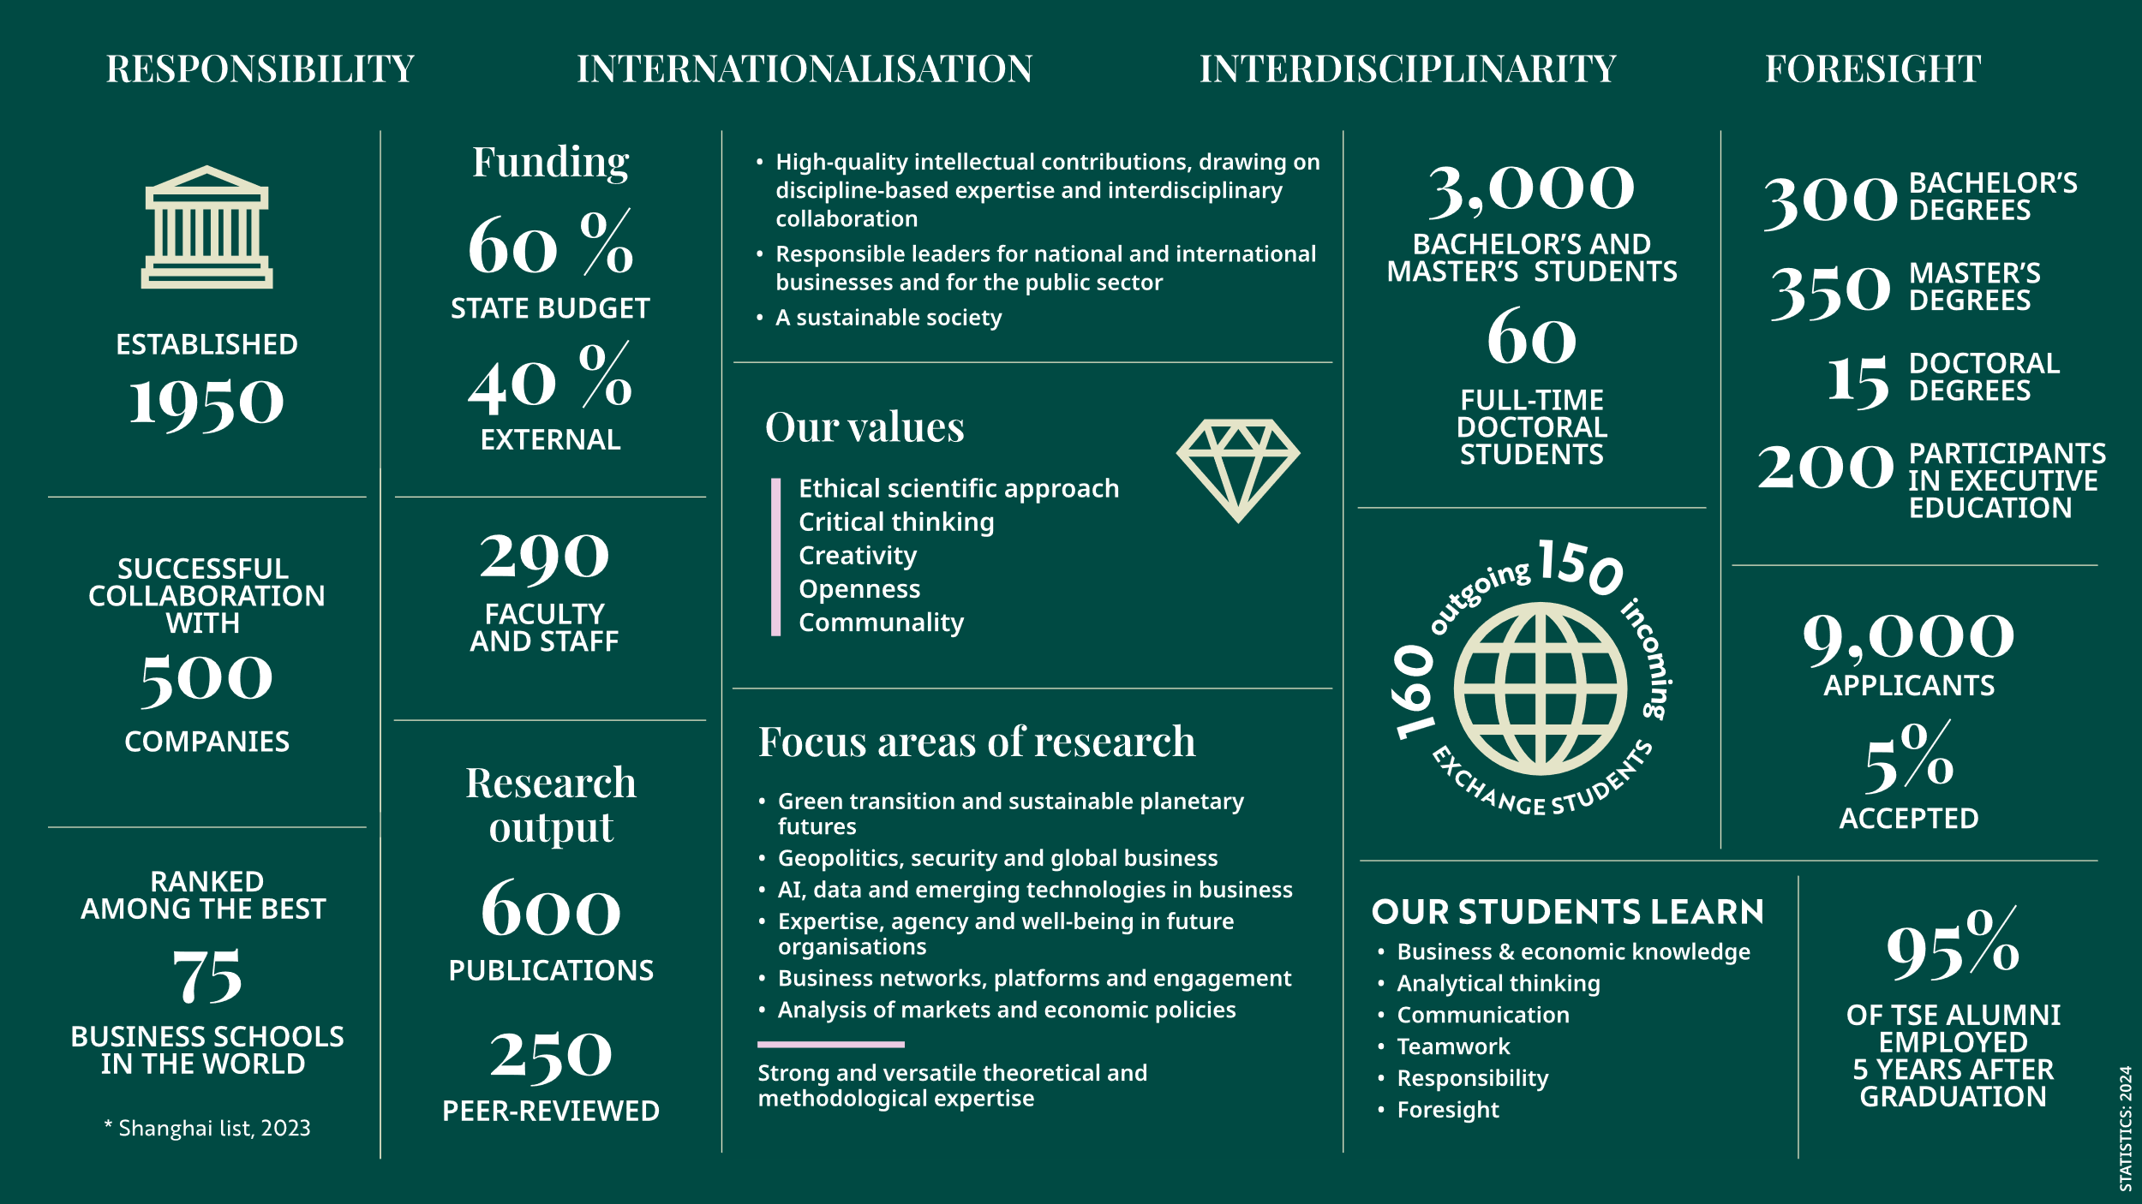

Slide 4
Mission
Vision
Values
Our mission is that we produce high-quality intellectual contributions drawing on discipline-based expertise and interdisciplinary collaboration. Based on basic and applied research, we educate responsible leaders for national and international businesses and for the public sector. We build a sustainable society.
Our vision is to be a cutting-edge business school that addresses wicked societal problems. This requires interdisciplinary scholarship, a foresight mindset, and impactful long-term stakeholder collaboration. All our efforts echo “TSE for Sustainable Futures”.
The basis for all we do is ethical scientific approach that supports critical thinking, creativity and openness. Our staff and students act responsibly and are enthusiastic about their work. We take good care of their well-being and feelings of belonging to our community.

Slide 5
Multidisciplinary research
A few topical examples
In UTU’s multidisciplinary theme of Biodiversity and Sustainability, TSE tackles global grand challenges through Biodiversity Respectful Leadership, Climate Nudging, and several other research focus areas.
Maritime@TSE is platform for maritime sector research and innovation activities in the Turku School of Economics.
At TSE, we have a professorship in Health Economics and a joint doctoral programme with Faculty of Medicine
…and a professorship in Intelligent Studies together with the National Defence University.
In research, we collaborate actively with scholars from other scientific fields than business studies and economics. Around 40 % of our journal articles contribute to other fields than business or economics.

Slide 6
General information on DPTSE
We are a part of UTUGS (University of Turku Graduate School) that consists of 16 Doctoral Programmes which cover all eight faculties > https://www.utu.fi/en/research/utugs
Doctoral researchers at Turku School of Economics belong to
  the Doctoral Programme of Turku School of Economics (all majors except Health Economics), or
  the Doctoral Programme in Technology (major Information Systems Science), or
  The Doctoral Programme in Clinical Science (major Health Economics)
Around 170 active doctoral researchers (of >2,000 at UTU)
  40% full-time students, 60% part-time students
  37 % foreigners (2015: 13 %)
Three degrees:
  Doctor of Science in Economics and Business Administration (all majors),
  Doctor of Philosophy (all majors),
  Doctor of Social Sciences (major: Economics)
12 possible major subjects (disciplines, see next slide)
English is the main communication language of the Programme (courses, events, emails…)

Slide 7
Departments and subjects @ TSE
Department of Accounting and Finance
Accounting and Finance
Business Law
Quantitative Methods in Management
Department of Management and Entrepreneurship
Management and Organisation
Information Systems Science
Entrepreneurship
Department of Economics
Economics
Health Economics
Department of Marketing and International Business
Marketing
International Business
Supply Chain Management
Economic Geography
Finland Futures Research Centre (FFRC)
Futures Studies
TSE Pori
Accounting and Finance
Management and Organisation
Marketing
Entrepreneurship

Slide 8
Intake: applicants and admitted 2011-2025

Slide 9
Applying
Application periods are in March and in September
  25.8. - 8.9.2026 (study right begins 1.1.2027); possibility to apply for UTUGS funded positions
  16.3. - 30.3.2027 (study right begins 1.8.2027)
  https://www.utu.fi/en/tutkimus/tutkijakoulu/hakuohjeet
  As a general rule, no need to contact a Professor prior applying > Two supervisors and a tutor are appointed to each new selected student
Read carefully the call for applications, published by 30.6.2026 (https://www.utu.fi/en/research/utugs/doctoral-programme-of-turku-school-of-economics/admission-criteria-and-Instructions-for-applicants)
Apply in the electronic system (https://www.utu.fi/en/research/utugs/how-to-apply/call-for-applications)
Requirements:
  Research plan + Letter of motivation + good academic performance (https://www.utu.fi/en/university/turku-school-of-economics/research/doctoral-training/applying)
  Language requirements (https://www.utu.fi/en/research/utugs/how-to-apply/language)

Slide 10
Overview of the Evaluation Process of Applications
In Fall: a number of salaried positions are available. The disciplines select up to 3 candidates for salaries positions. To rank them, an internal and external evaluation of their applications is used. For this end, the Director of the Doctoral Programme of TSE nominates experts inside and outside of TSE, who review 2–3 applications each.
Two application periods each year: in March and in September.
The applications are first checked by the coordinator of the programme to fulfill the formal requirements.
Formally acceptable applications are sent for evaluation to the major subjects with the evaluation forms and the instructions. Responsible professors in each subject coordinate the evaluation process according to best practices (e.g. potential candidates are interviewed and their research plans are checked using electronic plagiarism system).
The Dean will make the final decision on the study rights.
The Steering Committee of the Doctoral Programme of TSE makes a proposal of the candidates to be selected based on:
the major subjects’ assessments
(the internal and external reviews)
an overall assessment done by the Steering Committee of the Doctoral Programme

Slide 11
Major subject sessions in breakout rooms
Next you will see a list of possible breakout rooms by the name of the major > choose the correct one on the list
You are free to talk about any topic you want to (e.g. financing, potential research topics, Turku as a place to live …)
If you want to change a breakout room, you can do so by clicking the three dots at the bottom of the screen and selecting ”breakout rooms”
You can also return to the main session if you have any questions to the coordinator Jenni Gray and then return to your major’s breakout room.
If any questions comes to mind later on, contact Jenni at tsedoctoralprogramme@utu.fi

